Slide 1
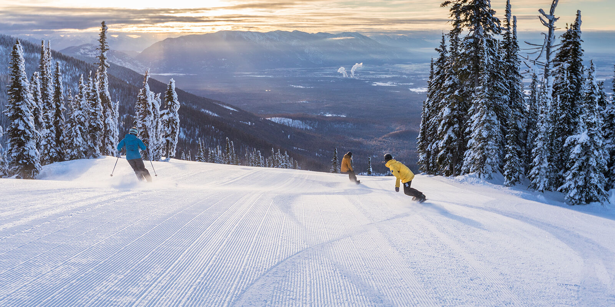
Guided Capstone Project Presentation
Can Big Mountain Resort sustain a lift ticket price increase to offset the operational cost increase of $1.5M for the new lift during the upcoming winter sports season?

Slide 2
The Big Mountain Resort Pricing Question
With the addition of a new lift, there is an increase in the operational costs of $1.5 for the upcoming ski season. How will the resort be able to cover the additional amount?
The current ticket pricing model is based upon the market average plus a premium offset for the quality level of the resort. This may not be the optimal model as it is hard to quantify the quality level or comparable features between all the the resorts in the market.

Slide 3
Big Mountain Resort Pricing Recommendations
The key features identified by the data show that, yes Big Mountain Resort can increase its price to stay competitive within the market and cover the operational cost of the added lift.
The median sustainable price point for lift tickets with features matching Big Mountain Resort is $95.87 within a range of $85.48 to $106.26
The Vertical Drop, number of Lifts, highlighting the number of Fast Quads and number of Runs are the strongest indicators of Ticket Price valuation in the market.

Slide 4
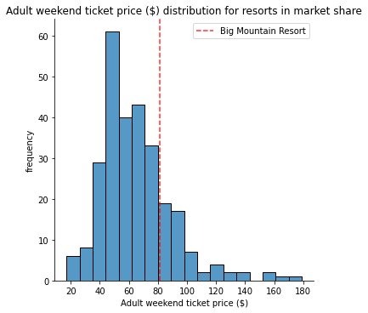
Baseline Pricing Model
Current average price of $81.00

Slide 5
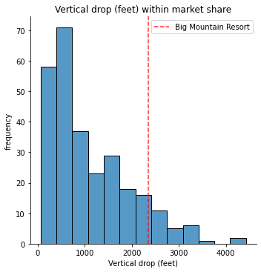
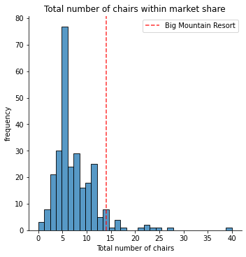
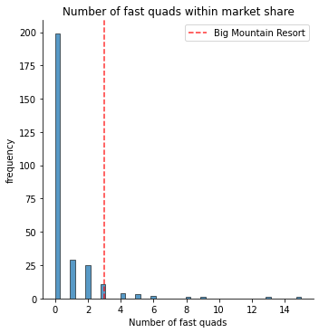
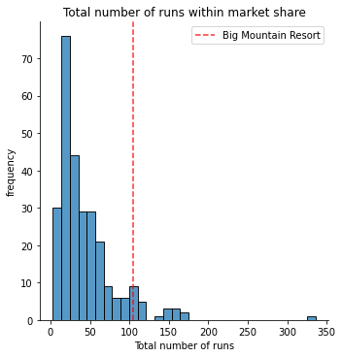
Big Mountain Resort Key Feature Positioning
The resort is positioned at the higher end of the key pricing features (Vertical Drop, Total Lifts, Fast Quads and Total Runs)

Slide 6
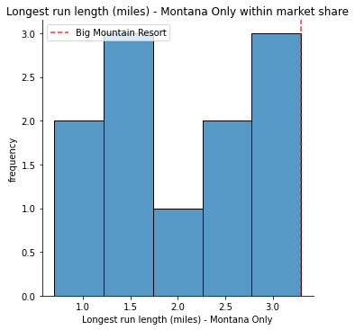
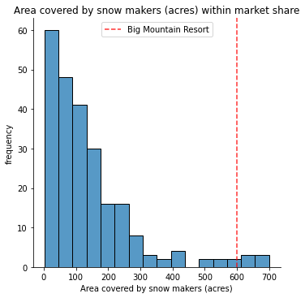
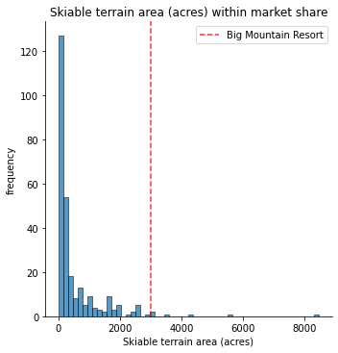
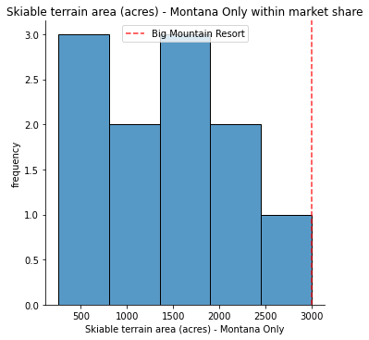
Secondary Pricing Features
Secondary Pricing features have a very small influence on total ticket pricing valuation, while worth note for marketing purposes.

Slide 7
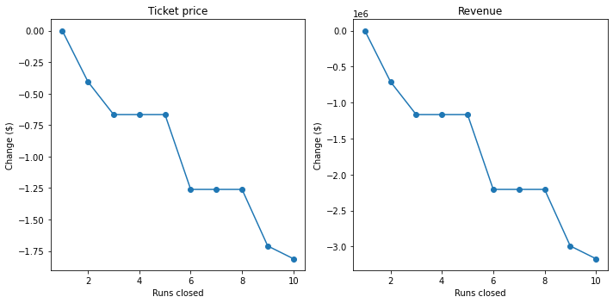
Big Resort Potential Scenarios
Closing Runs to reduce costs
Adding a run increasing Vertical Drop by 150 ft, supports an increase of ticket price by $1.99
Adding a run increasing Vertical Drop by 150 ft and 2 acres of snow making, supports an increase of ticket price by $1.99
Extending the longest run in Montana by 0.2 miles, will not affect ticket valuation.
Closing Runs to reduce costs

Slide 8
Big Mountain Resort Ticket Pricing Outcomes
The market will support increasing ticket prices to cover the cost of the newly added lift.
With a target ticket price range of $84.48 to $106.26 the target prices of $95.87 is the median suggested ticket price.
There are other pieces of data required to optimize cost reductions without cannibalizing the existing user base.

